Slide 1
HOSPITAL MANAGEMENT SYSTEM
DAMG 6210 Data Management and Database Design
Project Design and Development - Shantanu Zodey

Slide 2
OBJECTIVES
Administration/On-Boarding
Appointment scheduling
Data Records
Billings/Payments
Reporting
Accommodation/Room details

Slide 3






HIGH LEVEL DESIGN
CREATING TABLE STRUCTURE
EXECUTING STORED PROCEDURES, TRIGGERS AND UDF
In this phase, we are creating table structures for all the major components related to Hospital Management.
Stored procedures for finding available doctors and appointment, Triggers for sending appointment confirmation mail and UDF to get computed column of age
INSERTION OF DATA
SCHEDULING AN APPOINTMENT
Inserting data into Admin, Department, Doctors and Lab. Based on this data, patient will be registered and data will be inserted.
Once patient is registered, the appointment is been scheduled between doctor and patient and appointment confirmation mail is sent to patient.
MAINTAINING RECORD OF DOCTOR AND PATIENT
BILLING AND PAYMENT
In this phase, when the out time or discharge date of patient is updated in the system, the triggers will insert values in Billing and Payment record
After scheduling an appointment, a record will be created for maintaining history of Patients in Hospital

Slide 4
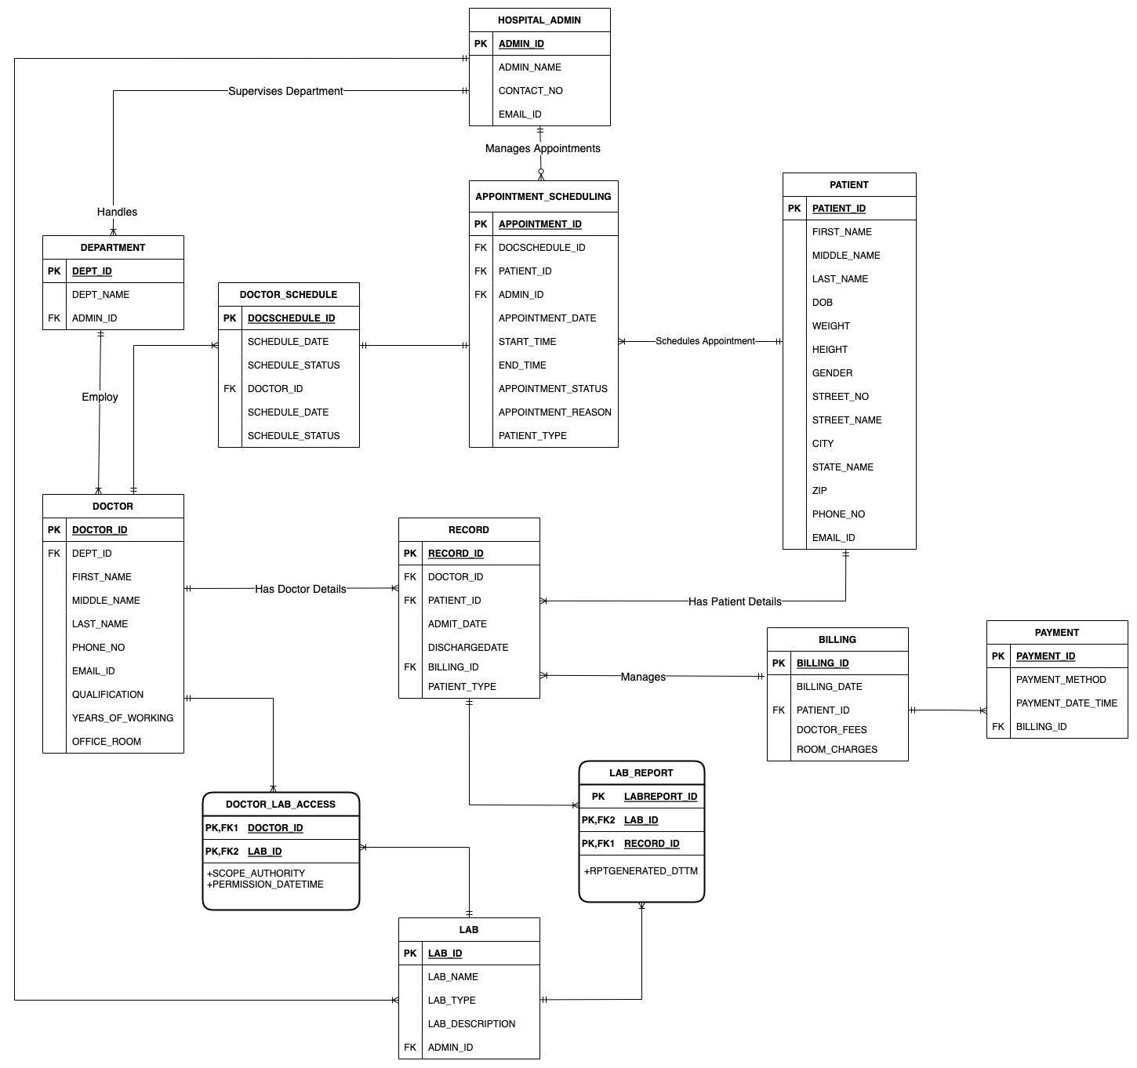
E-R DIAGRAM

Slide 5
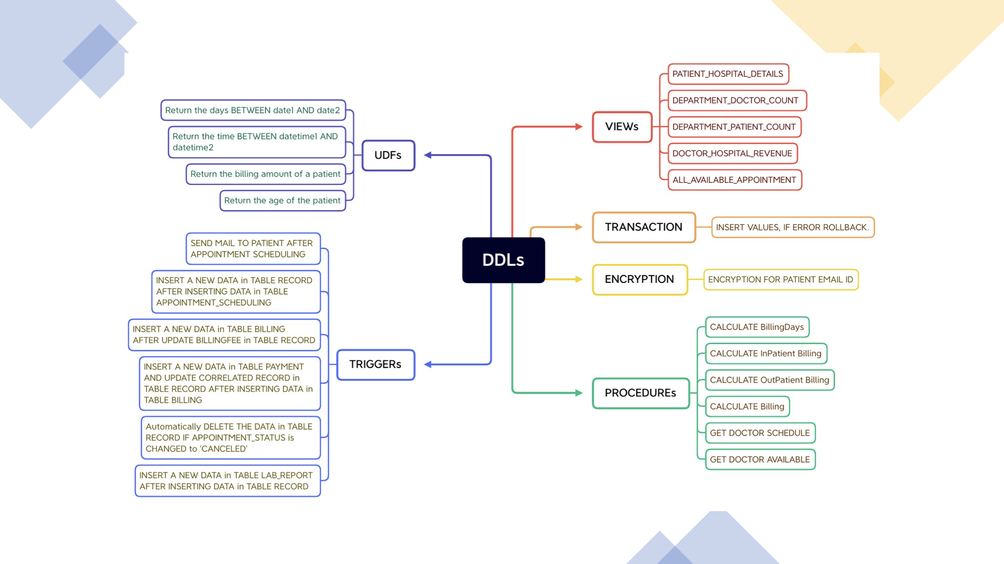
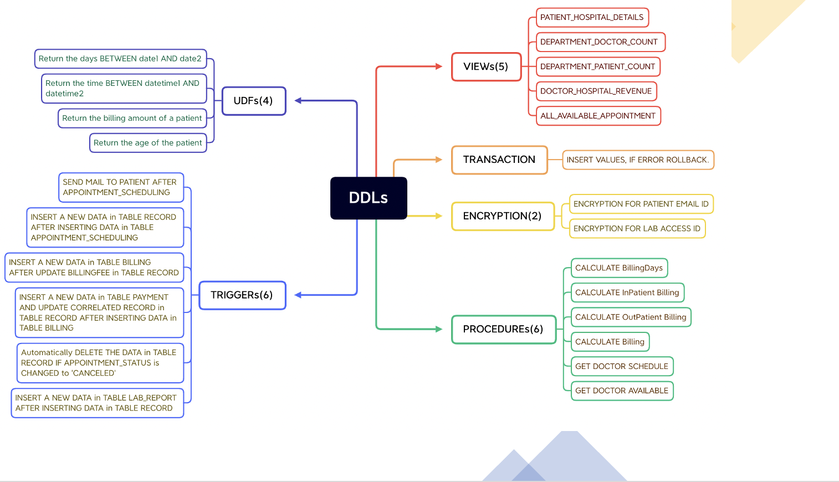
DATABASE OBJECTS

Slide 6
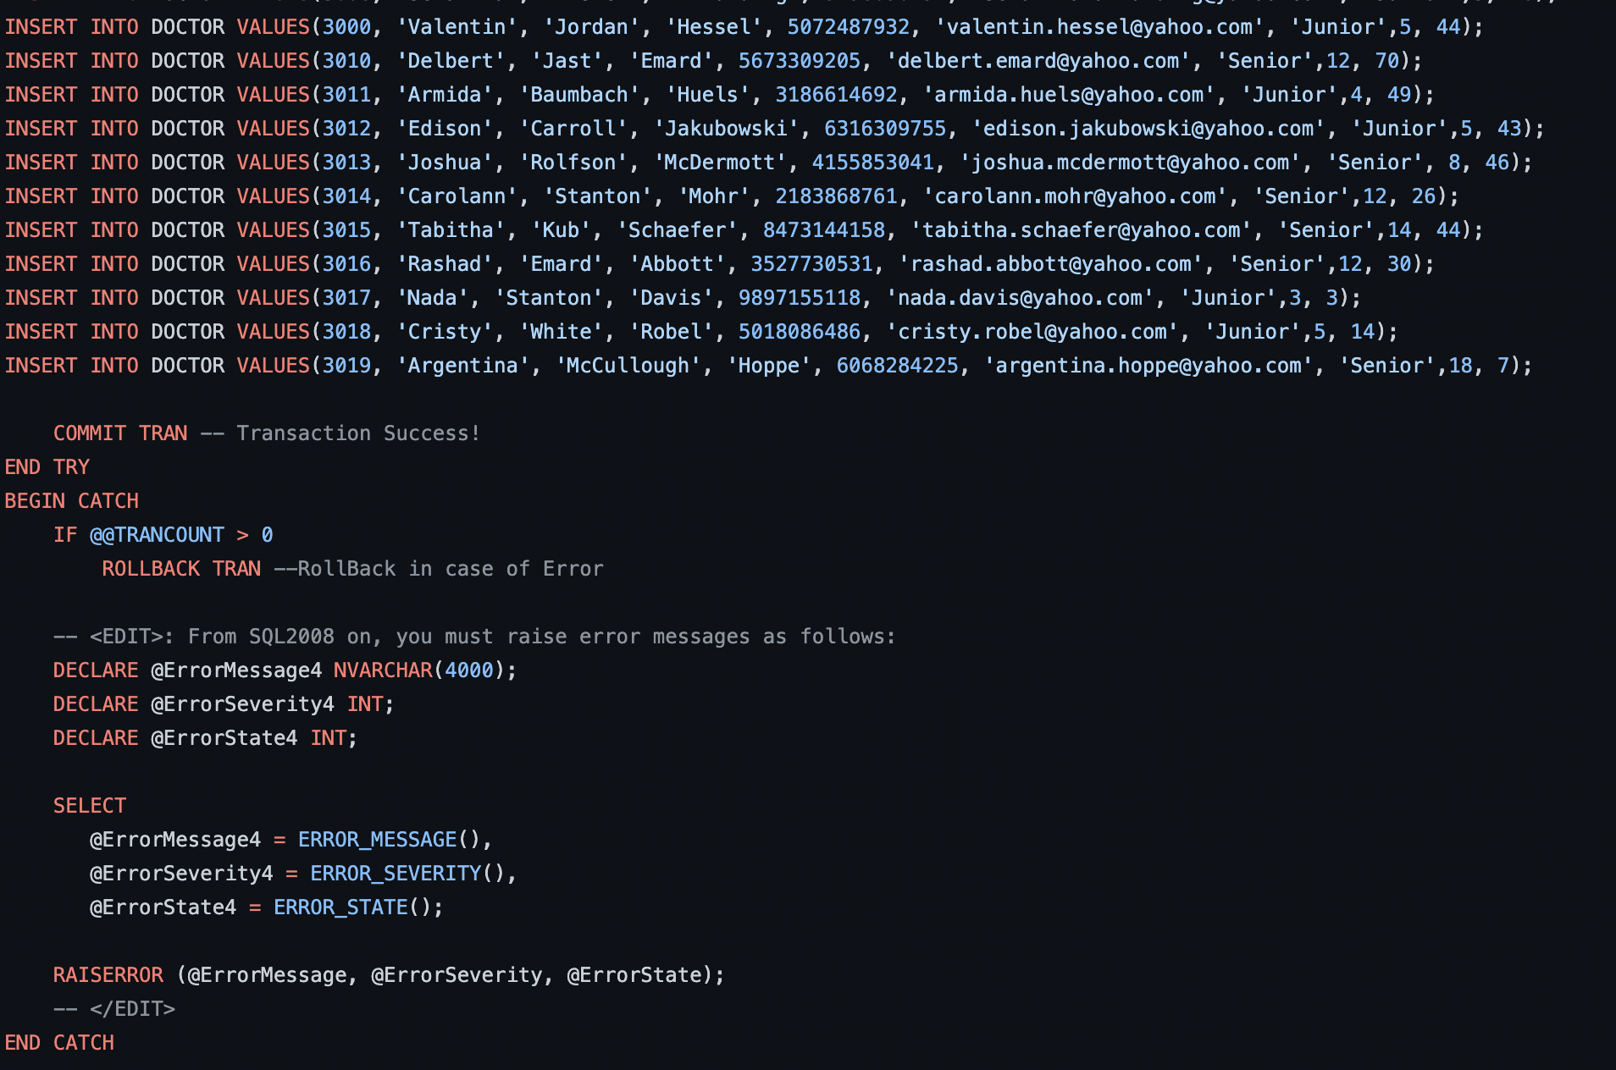
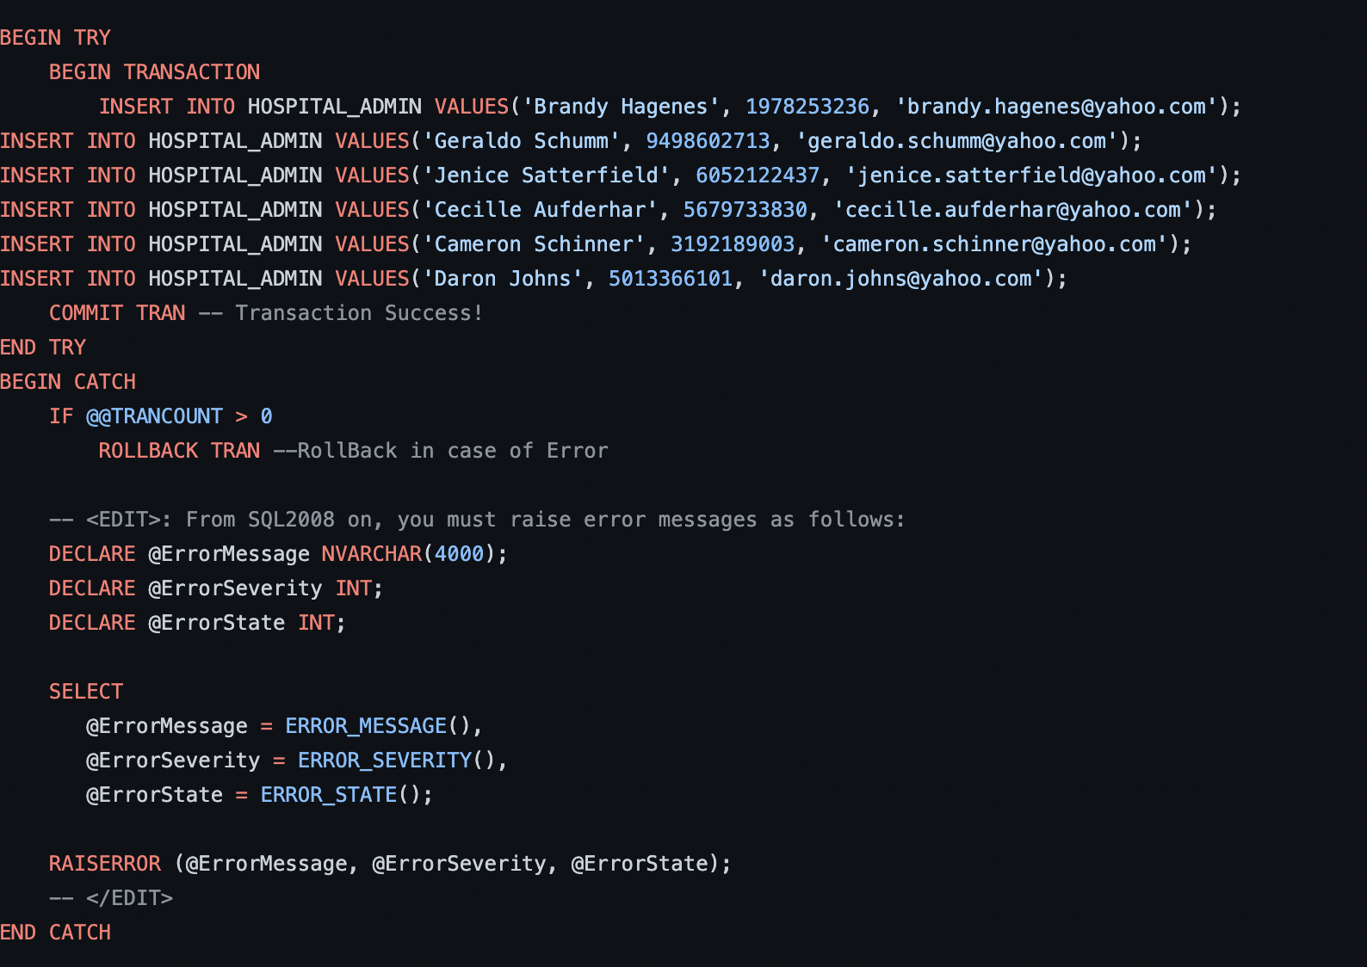
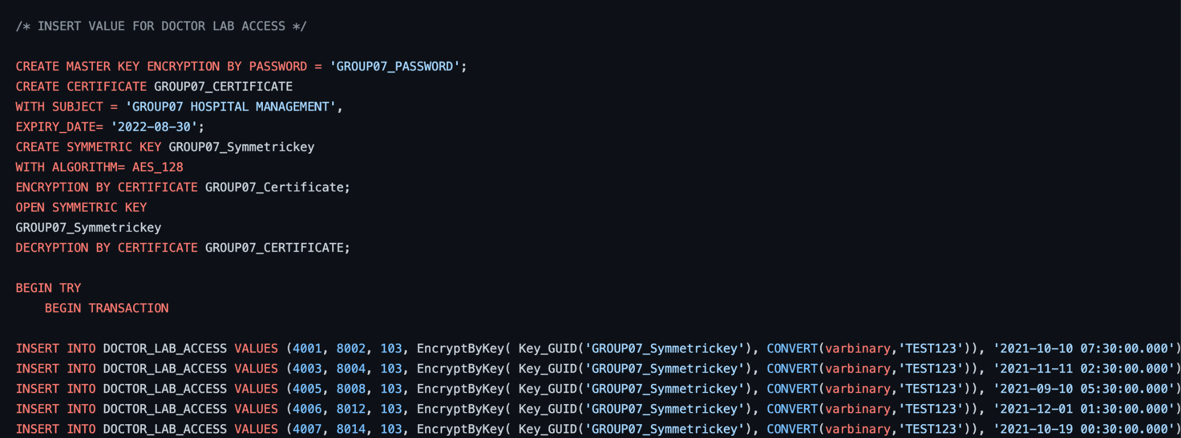
DDL SCRIPTS

Slide 7
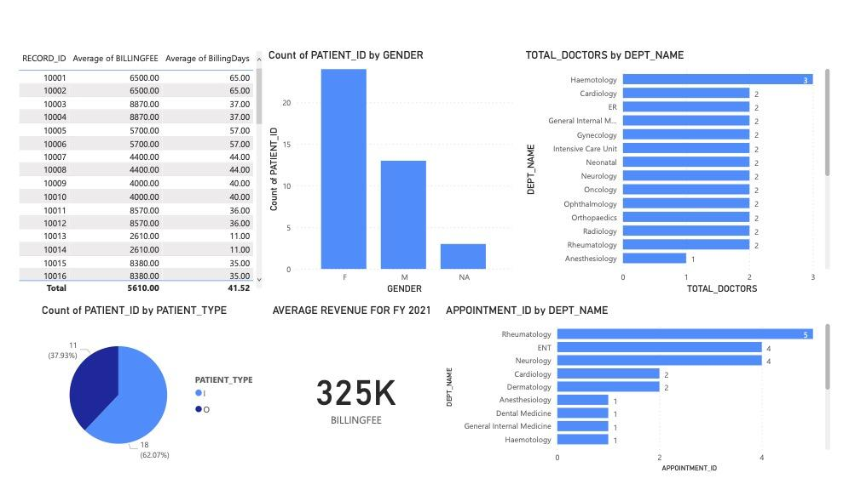
PowerBI Dashboard

